Slide 1
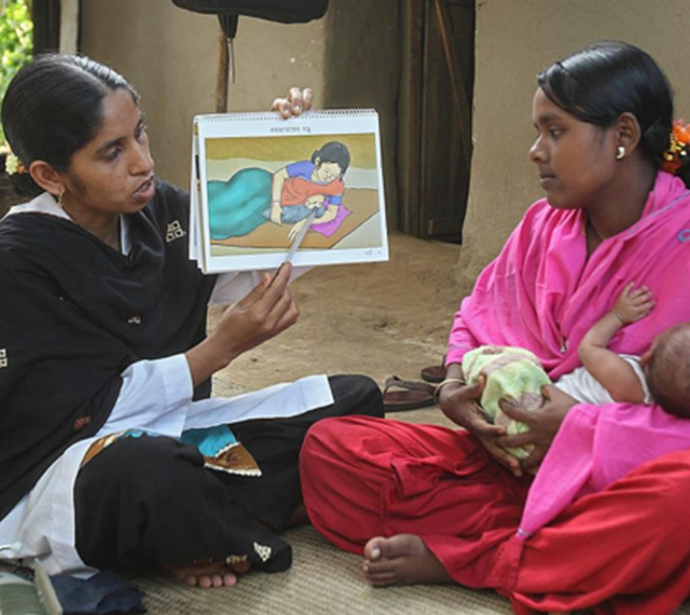

Shaako
Building Bridges to Better Health
A one stop solution for Community Health Worker Programs
1705045 - 1705051 - 1705056

Slide 2
Authority

Slide 3
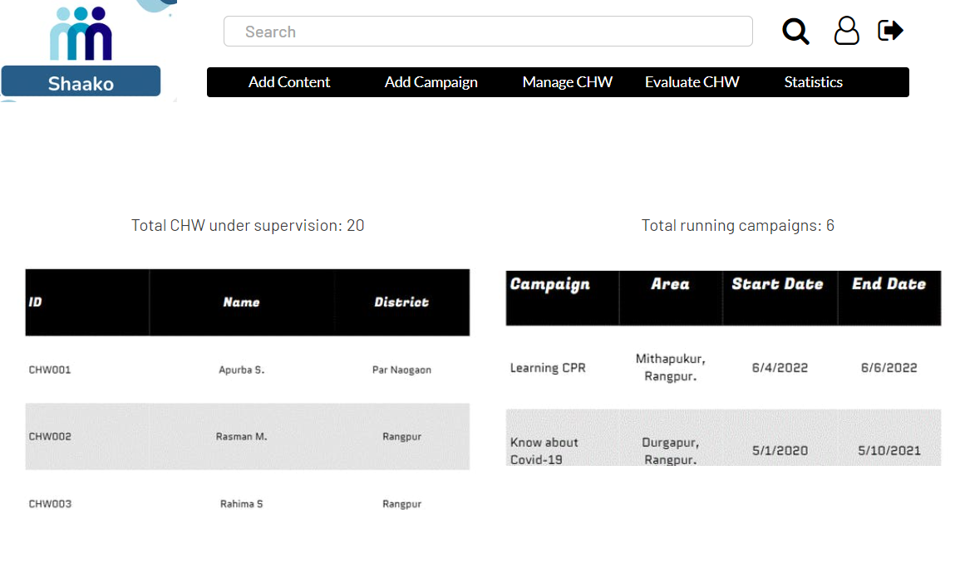
Home

Slide 4
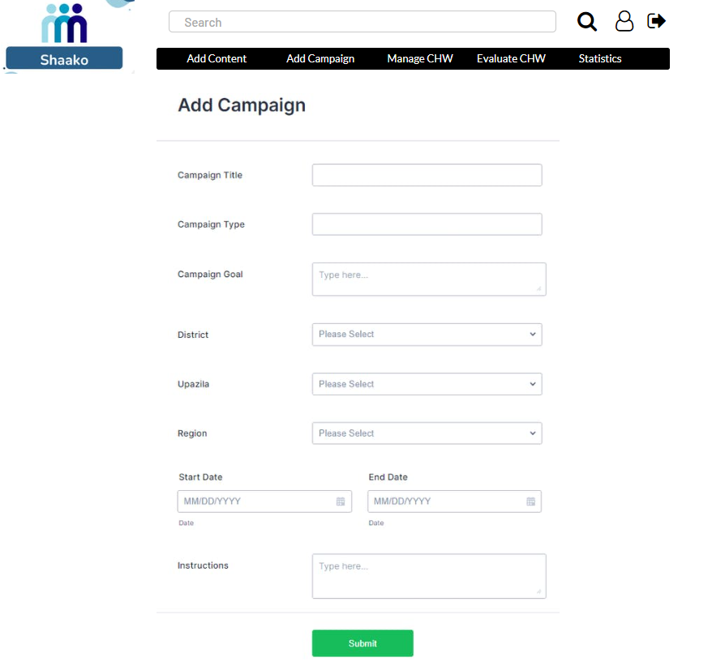
Add Campaign

Slide 5
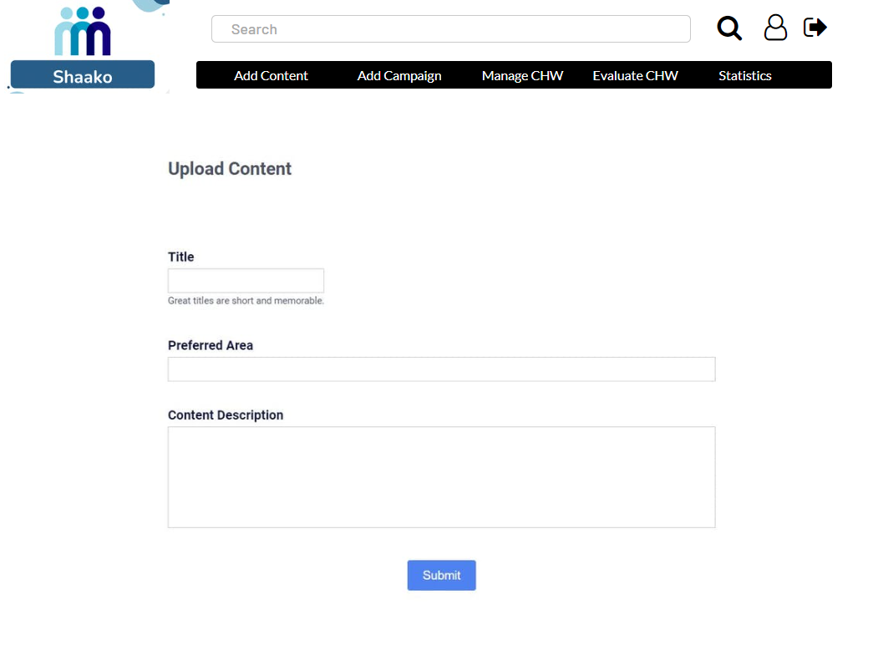
Add Content

Slide 6
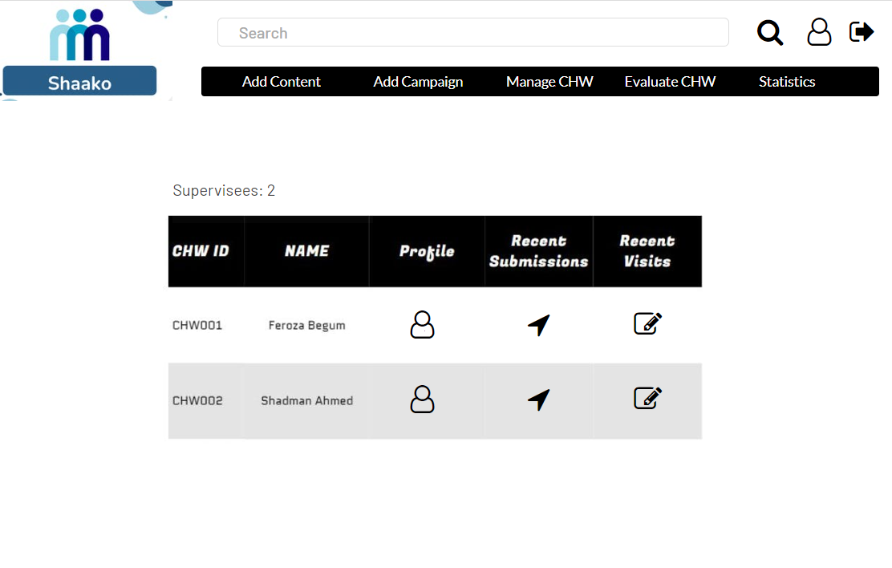
Supervisee List

Slide 7
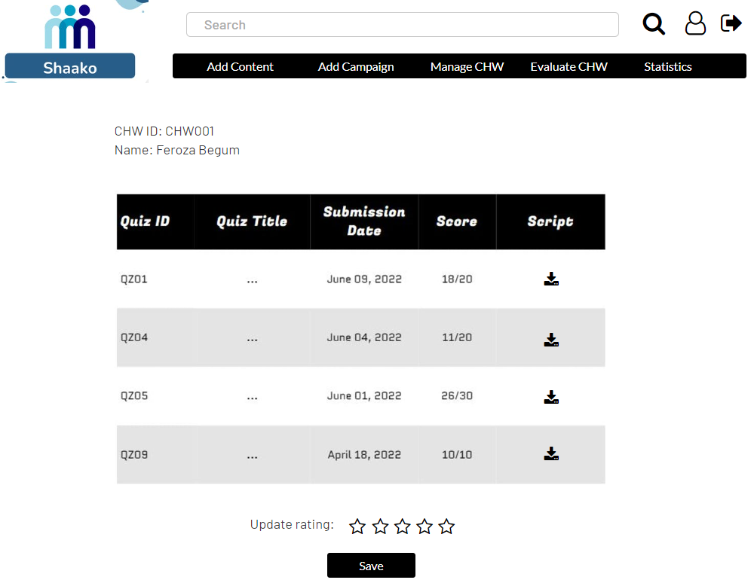
Evaluate CHW

Slide 8
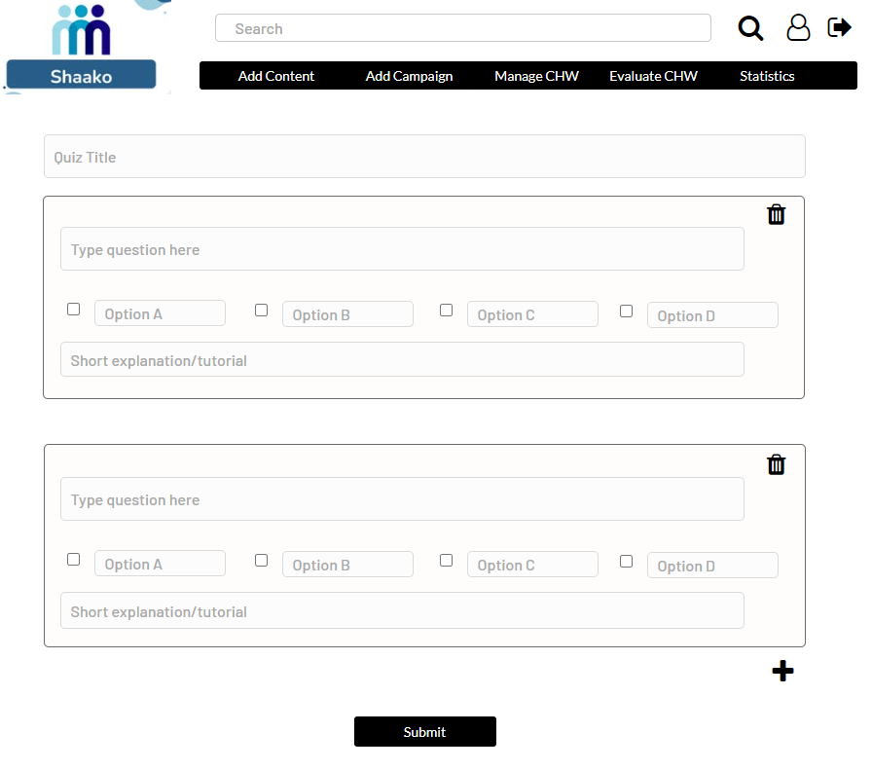
Add Quiz

Slide 9
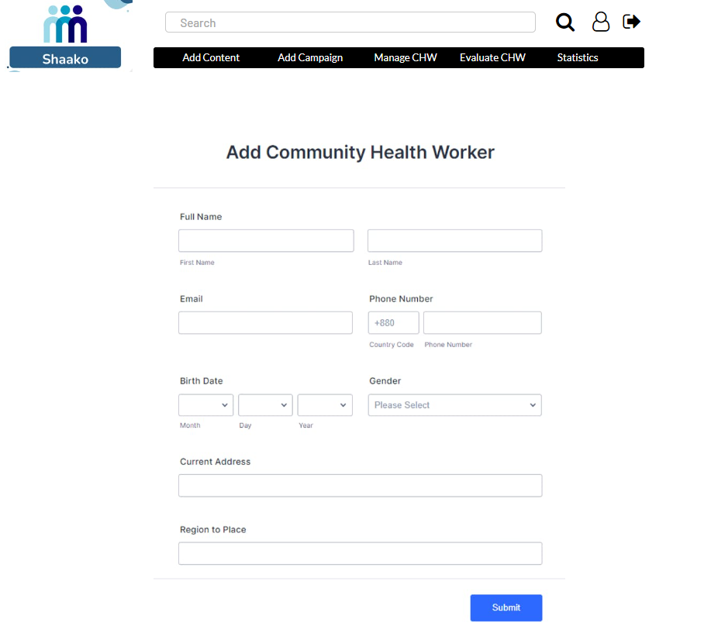
Add CHW

Slide 10
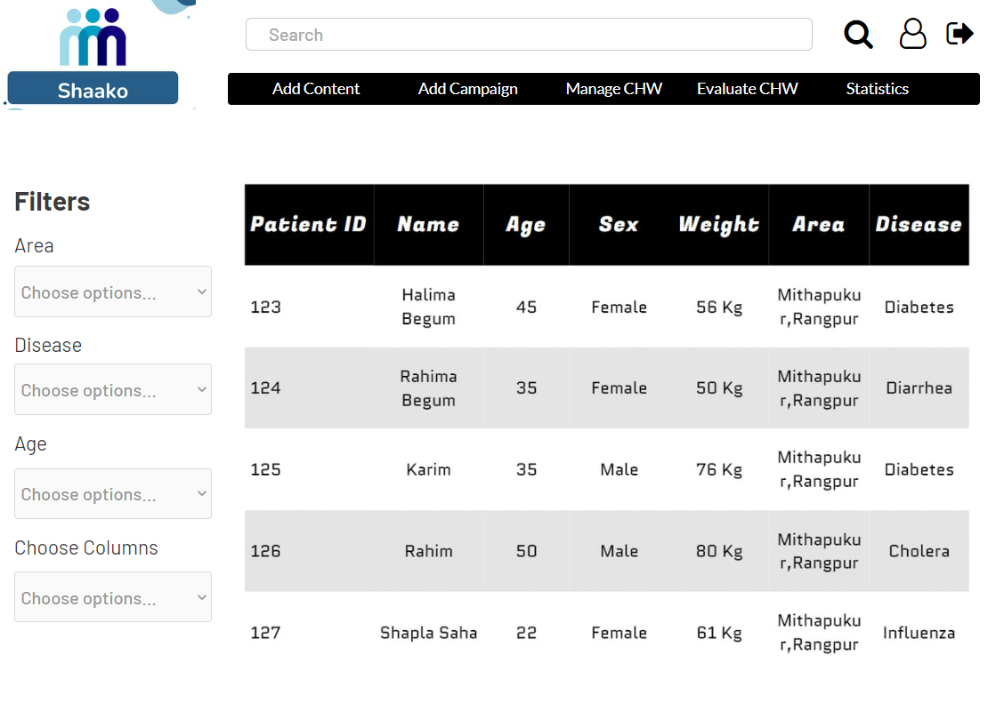
Statistics

Slide 11
Community Health Workers

Slide 12
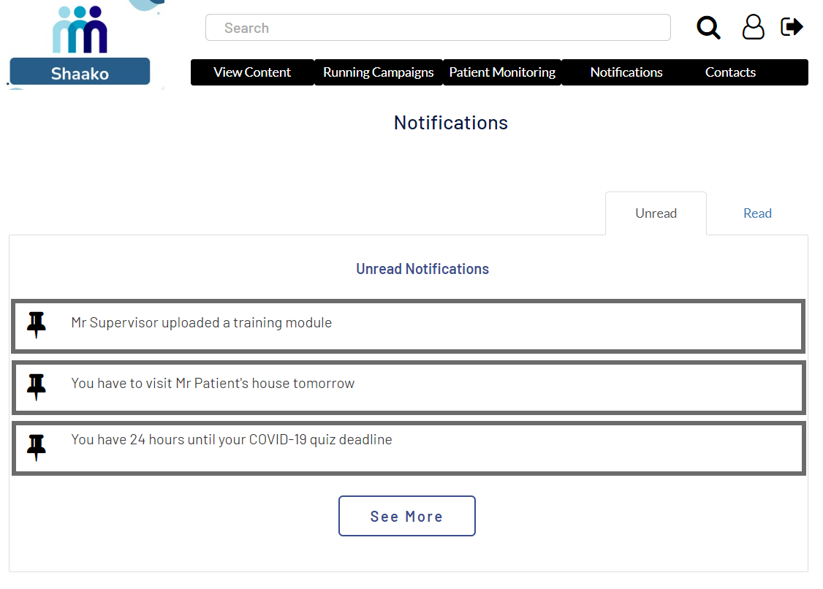
Notifications

Slide 13
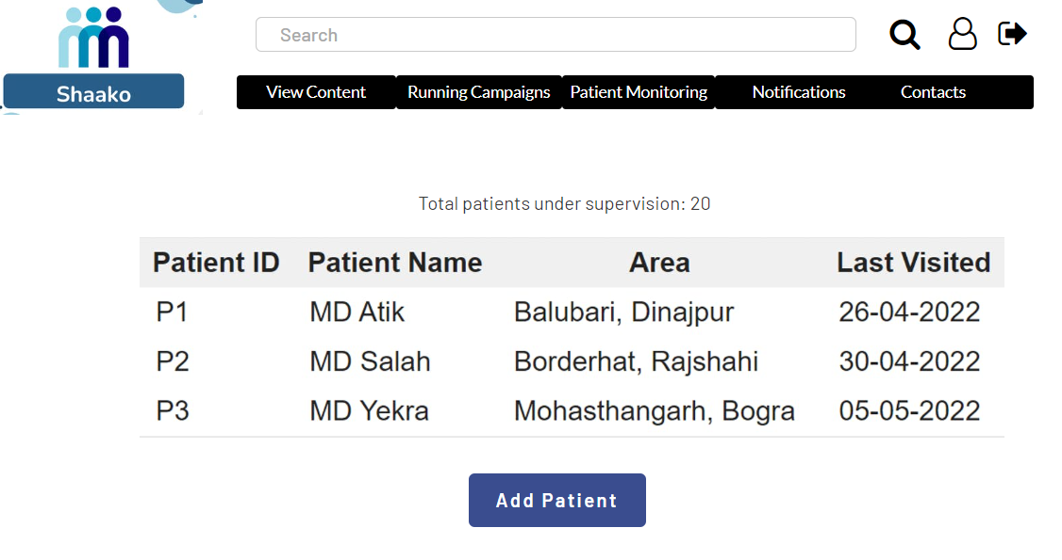
Patient

Slide 14
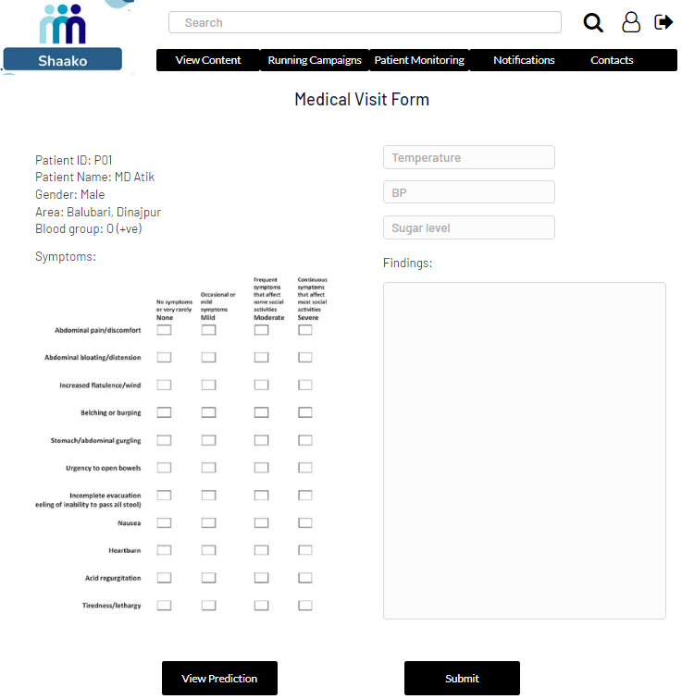
Medical Visit Form

Slide 15
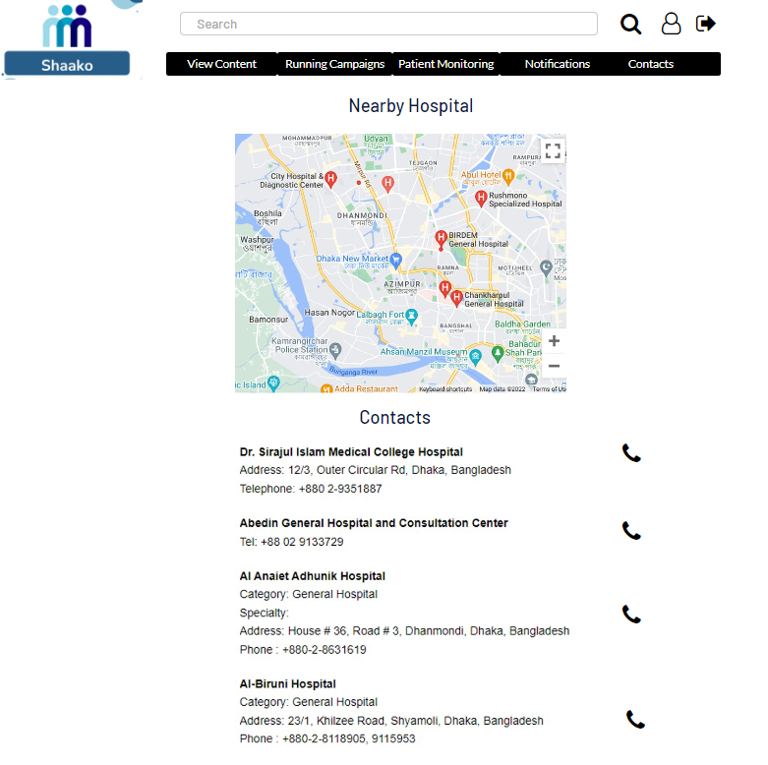
Nearby Hospital Finder

Slide 16
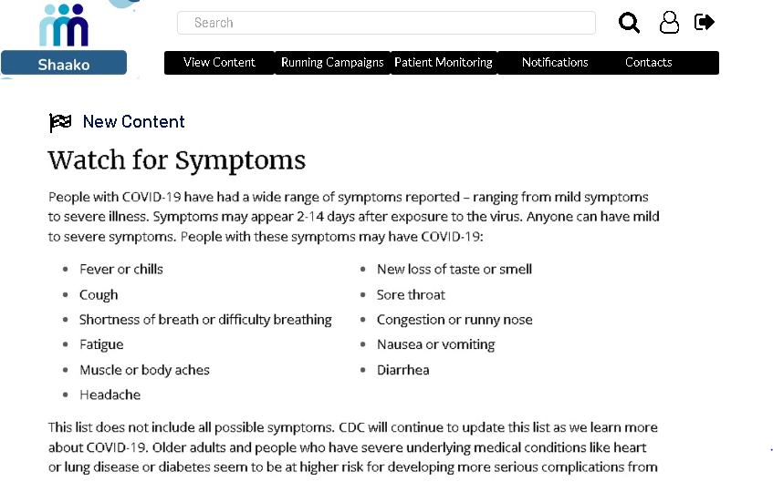
View Content

Slide 17
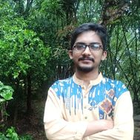
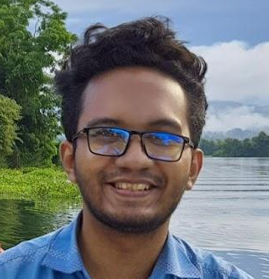
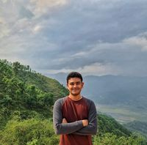
Our Team
Iftekhar Hakim Kaowsar
Rasman Mubtasim Swargo
Apurba Saha
1705045
1705051
1705056

